Slide 1


Stacks
Linear list.
One end is called top.
Other end is called bottom.
Additions to and removals from the top end only.

Slide 2

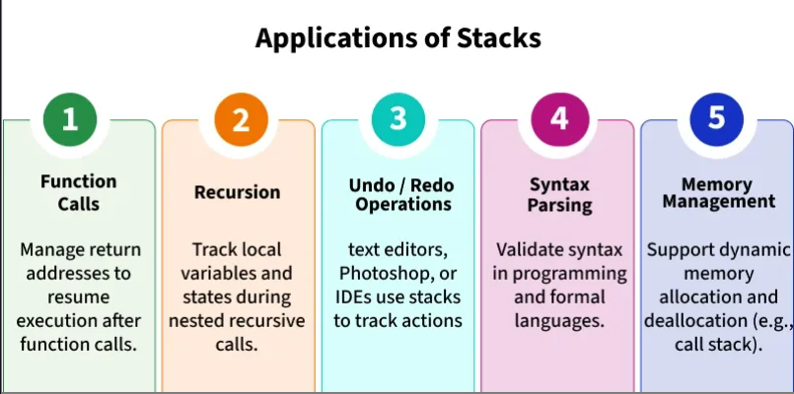
Application

Slide 3
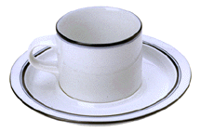
Stack Of Cups
top
F
top
E
E
D
D
C
C
B
B
bottom
bottom
A
A
Add a cup to the stack.
Remove a cup from new stack.
A stack is a LIFO list.
Notes:
Picture is really a stack of cups and saucers.
LIFO = last in first out. The first cup that is removed from a stack of cups is the
Last one that was added to the stack.
Other examples of LIFO lists in real life: stack of trays in a cafeteria; paper stack in a printer or copy machine; newspaper stack at a news stand.

Slide 4
Parentheses Matching
(((a+b)*c+d-e)/(f+g)-(h+j)*(k-l))/(m-n)
  Output pairs (u,v) such that the left parenthesis at position u is matched with the right parenthesis at v.
    (2,6) (1,13) (15,19) (21,25) (27,31) (0,32) (34,38)
(a+b))*((c+d)
  (0,4)
  right parenthesis at 5 has no matching left parenthesis
  (8,12)
  left parenthesis at 7 has no matching right parenthesis
Notes:
Matching parenthesis is nearest unmatched parenthesis on left.

Slide 5
Parentheses Matching
scan expression from left to right
when a left parenthesis is encountered, add its position to the stack
when a right parenthesis is encountered, remove matching position from stack

Slide 6
Example
(((a+b)*c+d-e)/(f+g)-(h+j)*(k-l))/(m-n)
2
1
0

Slide 7
Example
(((a+b)*c+d-e)/(f+g)-(h+j)*(k-l))/(m-n)
15
1
0
(2,6)
(1,13)

Slide 8
Example
(((a+b)*c+d-e)/(f+g)-(h+j)*(k-l))/(m-n)
21
1
0
(2,6)
(1,13)
(15,19)

Slide 9
Example
(((a+b)*c+d-e)/(f+g)-(h+j)*(k-l))/(m-n)
27
1
0
(2,6)
(1,13)
(15,19)
(21,25)

Slide 10
Example
(((a+b)*c+d-e)/(f+g)-(h+j)*(k-l))/(m-n)
1
0
(2,6)
(1,13)
(15,19)
(21,25)
(27,31)
(0,32)
and so on

Slide 11
Towers Of Hanoi/Brahma
4
3
2
1
A
B
C
64 gold disks to be moved from tower A to tower C
each tower operates as a stack
cannot place big disk on top of a smaller one
Notes:
Could use animation of towers of hanoi from animations page on Web site.
Also known as Towers of Brahma.
According to legend, on the day of creation Buddhist monks began the task of moving disks from tower A to tower C. When they get done, the world will come to an end.

Slide 12
Towers Of Hanoi/Brahma
3
2
1
A
B
C
3-disk Towers Of Hanoi/Brahma

Slide 13
Towers Of Hanoi/Brahma
2
1
3
A
B
C
3-disk Towers Of Hanoi/Brahma

Slide 14
Towers Of Hanoi/Brahma
1
2
3
A
B
C
3-disk Towers Of Hanoi/Brahma

Slide 15
Towers Of Hanoi/Brahma
3
1
2
A
B
C
3-disk Towers Of Hanoi/Brahma

Slide 16
Towers Of Hanoi/Brahma
3
2
1
A
B
C
3-disk Towers Of Hanoi/Brahma

Slide 17
Towers Of Hanoi/Brahma
3
2
1
A
B
C
3-disk Towers Of Hanoi/Brahma

Slide 18
Towers Of Hanoi/Brahma
2
3
1
A
B
C
3-disk Towers Of Hanoi/Brahma

Slide 19
Towers Of Hanoi/Brahma
3
2
1
A
B
C
3-disk Towers Of Hanoi/Brahma
7 disk moves

Slide 20
Recursive Solution
1
A
B
C
n > 0 gold disks to be moved from A to C using B
move top n-1 disks from A to B using C

Slide 21
Recursive Solution
1
A
B
C
move top disk from A to C

Slide 22
Recursive Solution
1
A
B
C
move top n-1 disks from B to C using A

Slide 23
Recursive Solution
1
A
B
C
moves(n) = 0 when n = 0
moves(n) = 2*moves(n-1) + 1 = 2^{n}-1 when n > 0

Slide 24

Lets Play a Game
Move all the disks from A to C
Never put the big disk on top the little disk
http://towersofhanoi.info/Play.aspx

Slide 25
Towers Of Hanoi/Brahma
moves(64) = 1.8 * 10¹⁹ (approximately)
Performing 10⁹ moves/second, a computer would take about 570 years to complete.
At 1 disk move/min, the monks will take about 3.4 * 10¹³ years.
Notes:
At the rate of a billion moves/second it would take 570 years to complete the task of moving 64 disks. Of course, the Buddhist monks engaged in this activity are moving far fewer disks/second. At the rate of (say) 1 disk a minute (the disks are, after all, rather heavy), the monks will take about 3.4 * 10¹³ years. So there is quite a while to go before the world comes to an end.

Slide 26
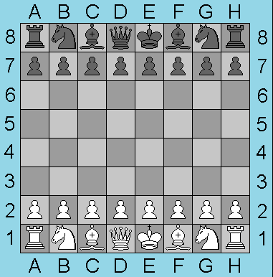
Chess Story
1 grain of rice on the first square, 2 for next, 4 for next, 8 for next, and so on.
Surface area needed exceeds surface area of earth.
Notes:
According to legend, the game of chess was developed for a king. The king was so pleased with the game that he offered its developer any reward he chose. The developer asked for 1 grain of rice for the first square, 2 for the next, 4 for the next, and so on. Not being a computer scientist, the king figured he was getting off cheap and asked his finance minister to reward the developer in the chosen manner. Assume that rice grains are not placed one on top of another. Each grain occupies a 1cm x 0.2 cm rectangle, for an area of 0.2 sq cm. We need 2⁶⁵ –1, which is roughly 3.6 * 10¹⁹, grains. The total area required is 7.2 * 10¹⁴ m². The area of the earth’s surface is approximately 5 * 10¹⁴ m².
A modern version of this would be 1 penny for the first square, 2 for the next, and so on. The payment would amount to about $3.6 * 10¹⁷. By comparison, the annual Federal budget is about $2 trillion = $2 * 10¹². Assuming a stationary budget, it would take about 180,000 years worth of Federal budget to pay the developer of chess.

Slide 27
Chess Story
1 penny for the first square, 2 for next, 4 for next, 8 for next, and so on.
$3.6 * 10¹⁷ (federal budget ~ $2 * 10¹²) .

Slide 28
Switch Box Routing
1
2
3
4
5
6
7
8
9
10
40
11
39
12
38
13
37
14
36
Routing region
15
35
16
34
17
33
18
32
19
31
20
30
29
28
27
26
25
24
23
22
21

Slide 29
Routing A 2-pin Net
1
2
3
4
4
5
6
7
8
9
10
40
11
Routing for pins 5 through16 is confined to upper right region.
Routing for pins 1-3 and 18-40 is confined to lower left region.
39
12
38
13
37
14
36
15
35
16
34
17
17
33
18
32
19
31
20
30
29
28
27
26
25
24
23
22
21

Slide 30
Routing A 2-pin Net
1
2
3
4
4
5
6
7
8
9
10
40
11
Examine pins in clock-wise order beginn-ing with pin 1.
(u,v), u<v is a 2-pin net.
u is start pin.
v is end pin.
39
12
38
13
37
14
36
15
35
16
34
17
17
33
18
32
19
31
20
30
29
28
27
26
25
24
23
22
21

Slide 31
Routing A 2-pin Net
1
2
3
4
4
5
6
7
8
9
10
40
11
Start pin => push onto stack.
End pin => start pin must be at top of stack.
39
12
38
13
37
14
36
15
35
16
34
17
17
33
18
32
19
31
20
30
29
28
27
26
25
24
23
22
21

Slide 32
Method Invocation And Return
public void a()
{ …; b(); …}
public void b()
{ …; c(); …}
public void c()
{ …; d(); …}
public void d()
{ …; e(); …}
public void e()
{ …; c(); …}
return address in d()
return address in c()
return address in e()
return address in d()
return address in c()
return address in b()
return address in a()
Notes:
When a method is invoked, the address to return to following execution of the invoked method is pushed on to a stack. When a return is executed, a return to address (location in program) is popped from the stack and execution continues from that address.

Slide 33
Rat In A Maze
Notes:
Could use rat in a maze animation from Web site instead.
First step is for rat to enter the maze.
Orange and green squares are squares the rat can move to; blue squares cannot be moved to.

Slide 34
Rat In A Maze
Move order is: right, down, left, up
Block positions to avoid revisit.
Notes:
Now rat has a choice of direction to move. Arbitrarily select the above order. As the rat moves from one position to the next, a scent is left at the moved from position so the rat doesn’t enter that position again (avoids going in circles).

Slide 35
Rat In A Maze
Move order is: right, down, left, up
Block positions to avoid revisit.
Notes:
Yellow squares are squares on stack.

Slide 36
Rat In A Maze
Move backward until we reach a square from which a forward move is possible.

Slide 37
Rat In A Maze
Move down.
Notes:
Red squares are squares we have been to but are not on stack. Red squares should not be moved to again. Yellow squares may have adjacent squares not yet moved to.

Slide 38
Rat In A Maze
Move left.

Slide 39
Rat In A Maze
Move down.

Slide 40
Rat In A Maze
Move backward until we reach a square from which a forward move is possible.

Slide 41
Rat In A Maze
Move backward until we reach a square from which a forward move is possible.
Move downward.

Slide 42
Rat In A Maze
Move right.
Backtrack.

Slide 43
Rat In A Maze
Move downward.

Slide 44
Rat In A Maze
Move right.

Slide 45
Rat In A Maze
Move one down and then right.

Slide 46
Rat In A Maze
Move one up and then right.

Slide 47
Rat In A Maze
Move down to exit and eat cheese.
Path from maze entry to current position operates as a stack.

